Slide 1
IDAHO Healthcare Directive
Kimberly Ouwehand
O 208.505.4001 | M 208-369-6793 | F 208.813.6395
Enhabit Home Health & Hospice
Often referred to as a Living Will

Slide 2

IDAHO Advanced Directive
Includes the three parts:
DURABLE POWER OF ATTORNEY FOR HEALTHCARE
LIVING WILL
IDAHO POST (Physicians Order for Scope of Treatment) DNR

Slide 3
Key Points:
Having it done BEFORE a healthcare crisis.
You never know WHEN you will need someone to speak for you
Update whenever there is a change, ie: Children, changes in health, caring for someone else
When it is used and what it covers
Understanding Durable Power of Attorney (DPOA)
Where to find the document

Slide 4

1. IDAHO Durable Power of Attorney for Healthcare:
The Durable Power of Attorney for Healthcare is a legal document that allows you to name an individual who will speak on your behalf if you are unable to communicate or make decisions about your medical care.
This individual is called your Healthcare Agent, and their job is to tell your healthcare team about your wishes and speak up about the kind of care you want.
It is very important to discuss your values, wishes, and instructions with your Healthcare Agent when you create your Advance Directive. These discussions may continue after the document is signed and when situations change.

Slide 5
What is “Durable”
The agent in a Durable Power Of Attorney (DPOA) continues to act on behalf of the principal if the latter becomes *incapacitated.
A non-durable or a simple Power of Attorney (POA) means the agent’s authority ends if the principal becomes *incapacitated (no longer can speak for themselves).
Medical POA is a limited type of authority allowing the agent to make decisions for medical care, including treatment, surgery, medication, end-of-life care, and choice of healthcare providers.
A power of attorney after death ceases to be effective. You can no longer legally act on behalf of the principal after they pass and find you trustworthy enough to perform their essential functions while still alive.

Slide 6

Who should be your Durable Power of Attorney for Healthcare:
1. This is a person you can talk to and who knows your wishes.
A person who knows you- well.
A person who you trust and is strong enough to advocate for you
A person who is capable and can communicate with your healthcare team.
A person who is willing- you have ASKED them if they will be your advocate.
A person who can be reached by phone or in person.
2. You may also identify alternate Healthcare Agents if your primary agent cannot serve.
A person who can be reached in case your primary can not be reached.

Slide 7
2. LIVING WILL (main part of Advanced Directives)
The Living Will allows you to make choices about any life-sustaining medical treatments you want or do not want during a medical crisis or at the end of life.
A Living Will is a legal document that specifies the type of medical care you want if you are unable to communicate your wishes.
If you are in a situation where you cannot speak for yourself, the medical team and hospital will consult your Living Will and speak with your Healthcare Agent to determine the path forward.
Note: Living Will- means while you are still alive or living.

Slide 8
LIVING WILL
This Advance Directive shall be effective only if I am unable to communicate my instructions and:
I have an incurable injury, disease, illness or condition AND a medical doctor who has examined me has certified:
i. That such injury, disease, illness, or condition is terminal; and
ii. That the application of artificial life-sustaining procedures
would serve only to prolong artificially my life; and
iii. That my death is imminent, whether or not artificial life-sustaining procedures are utilized.
OR
B. I have been diagnosed as being in a persistent vegetative state

Slide 9
3. IDAHO POST
The Physician Orders for Scope of Treatment form, also called a POST, contains specific medical orders for individuals with a serious illness or approaching end of life and complements the Advance Directive.
A copy of this form is available on request by emailing ihdr@dhw.idaho.gov. Healthcare providers can also access the POST through the Idaho Healthcare Directive Registry.
This form must be completed and signed by you and your healthcare provider. Contact your healthcare provider to ask more about completing a POST.

Slide 10
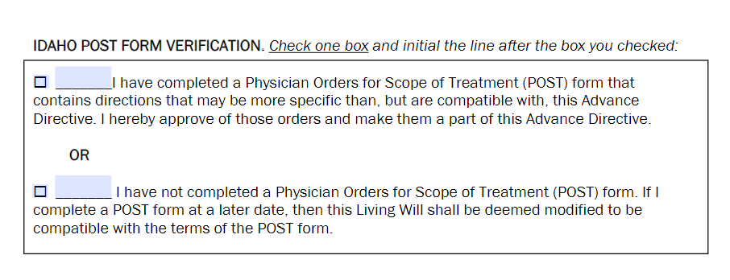


POST: Physician Order for Scope Of Treatment (what it looks like on the portion of the Advance Care Directives)
Often referred to as a Do Not Resituate (DNR)
Has two parts:

Slide 11
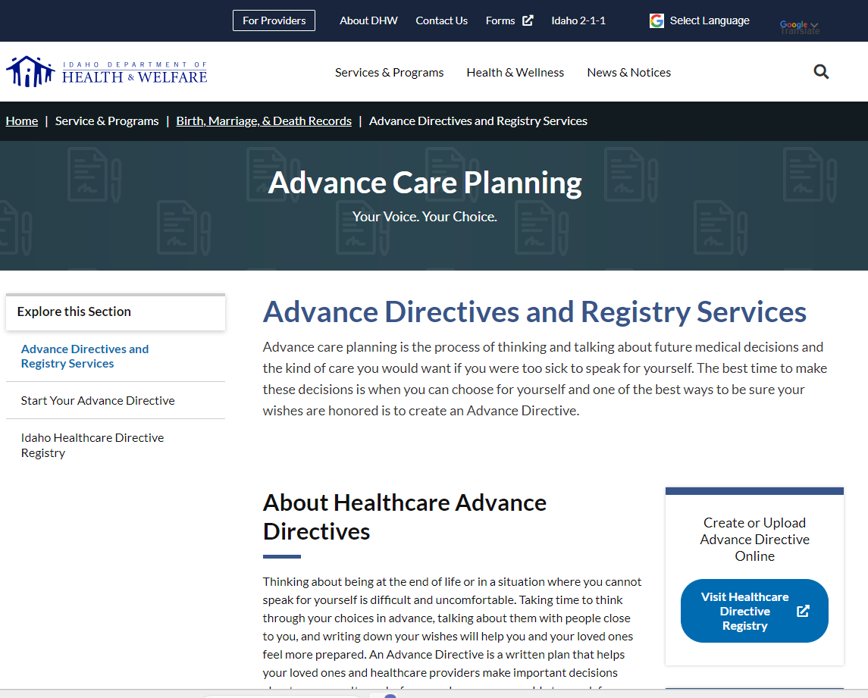
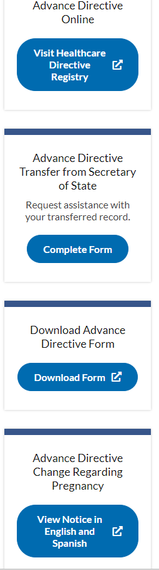
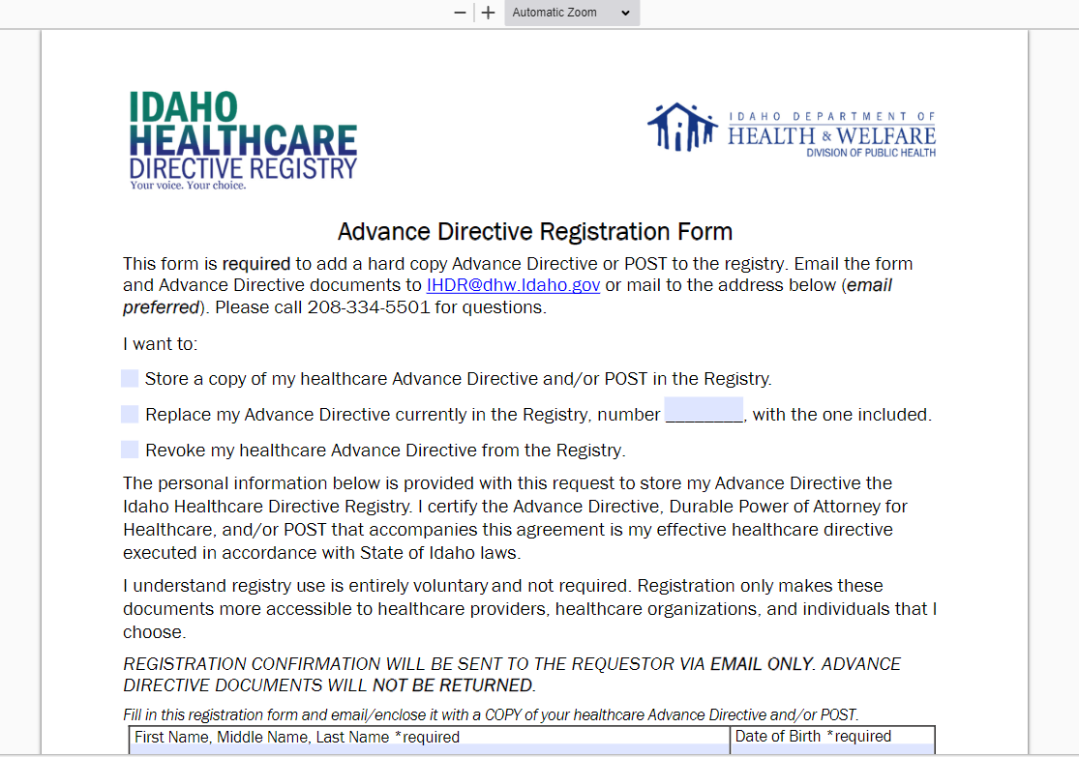
1. This is what the home page looks like: you want to be on the page:
Advance Directives and Registry Services
2. Scroll down and click on
Download Advance Directive Form
3. It will take you to the Advance Directive Registration Form: which you can download and review.

Slide 12
Where to find the document
Contact:
Idaho Healthcare Directive Registry:
450 W State Street, 4th Floor, P.O. Box 83720 Boise, ID 83720-0036
Phone: 208-334-5501 Email: IHDR@dhw.idaho.gov
Google: Idaho Health Care Directive

Slide 13
THANK YOU
ENHABIT Home Health and Hospice:
Kimberly Ouwehand
O 208.505.4001 | M 208.369.6793 | F 208.813.6395
Enhabit Home Health & Hospice

